Slide 1
Taking the ‘Dis out of Civil Discourse
Meg Heubeck
Director of instruction
UVA Center for Politics
Youth leadership Initiative

Slide 2
What’s going on in our schools?
American schools are increasingly segregated along racial, ethnic and economic lines.
Total number of public schools: 98,454
Percentage of students who are from low-income families: 51
Percentage of students who are Hispanic: 25
Percentage of students who are African American: 16
Percentage of students who are students of color: 50
Percentage of schools that are 70% or more minority: 26
Percentage of schools that are 70% or more white: 42
Percentage of schools with less than 70% of one racial group: 32
Souther Poverty Law Center
Survey of over 10,000 teachers, administrators and counselours from across the nation.

Slide 3
Results:
Nine out of 10 educators who responded have seen a negative impact on students’ mood and behavior following the election; most of them worry about the continuing impact for the remainder of the school year.
Eight in 10 report heightened anxiety on the part of marginalized students, including immigrants, Muslims, African Americans and LGBT students.
Four in 10 have heard derogatory language directed at students of color, Muslims, immigrants and people based on gender or sexual orientation.
Half said that students were targeting each other based on which candidate they’d supported.

Slide 4
Results (cont.)
Although two-thirds report that administrators have been “responsive,” four out of 10 don’t think their schools have action plans to respond to incidents of hate and bias.
Over 2,500 educators described specific incidents of bigotry and harassment that can be directly traced to election rhetoric. These incidents include graffiti (including swastikas), assaults on students and teachers, property damage, fights and threats of violence.
Because of the heightened emotion, half are hesitant to discuss the election in class. Some principals have told teachers to refrain from discussing or addressing the election in any way.

Slide 5
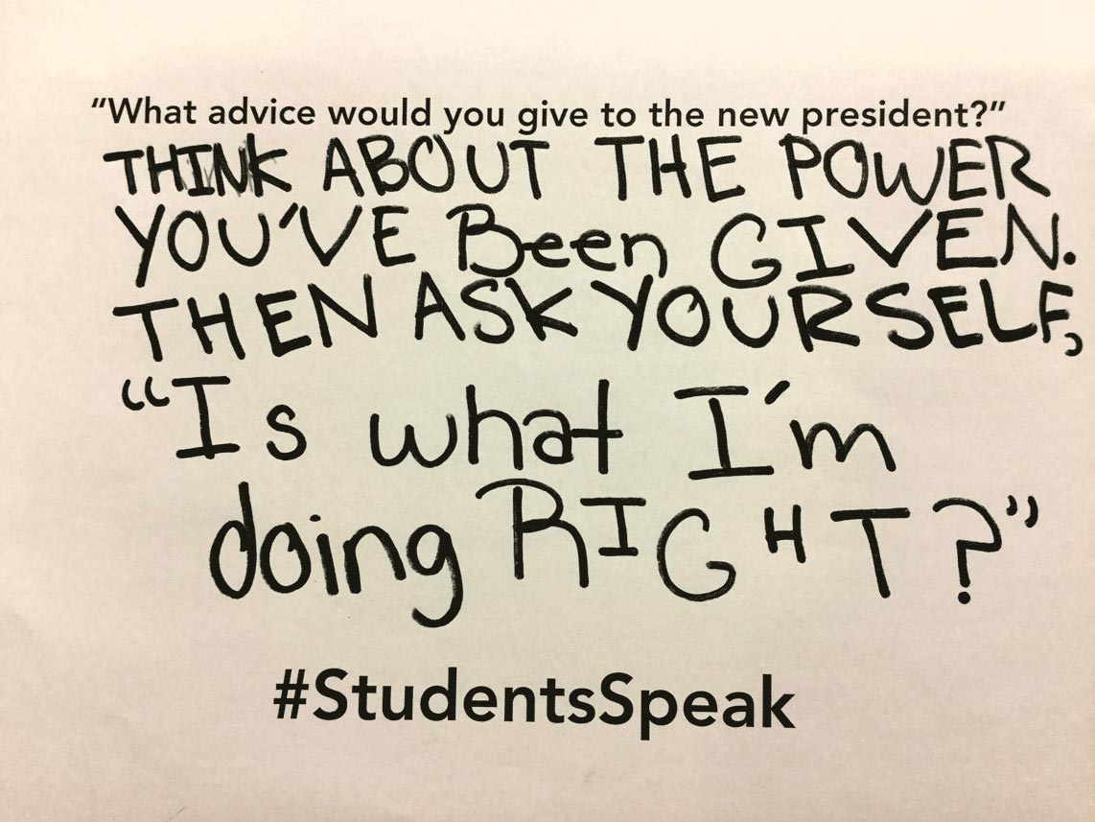
“The slurs have been written on assignments. ‘Send the Muslims back because they are responsible for 9/11.’” — HIGH SCHOOL TEACHER, MINNESOTA
“A proud proclamation of racism was made by a student after the election: ‘Bet those black people are really scared now.’” — HIGH SCHOOL TEACHER, MICHIGAN
“Kids saying, ‘Trump won, you’re going back to Mexico!’ Boys grabbing girls, cornering girls against lockers. Kids yelling, ‘Trump won, so [there will] be less people here soon.’” — HIGH SCHOOL TEACHER, KANSAS

Slide 6
“Kids did a ‘mock’ election where they got to vote for president and two of 32 kids voted for Trump (this was all before the actual election). One of the students who voted for Trump expressed that he felt kids were judging him for his choice and the teacher defended his position and right to have his own vote. He then said to the class, ‘I just want him to win so he can get rid of all the Mexicans.’ He himself is an immigrant from Bosnia.”— ELEMENTARY TEACHER, COLORADO
“The day after the election, white students in my school walked down the halls harassing their students of color. One student went around asking, ‘Are you legal?’ to each student he passed. Another student told his black classmate to ‘Go back to Haiti because this is our country now.’” — MIDDLE SCHOOL STUDENT TEACHER, MASSACHUSETTS

Slide 7
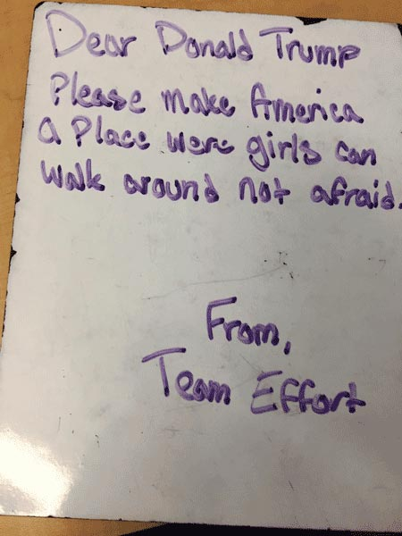
“There is a lack of trust in the school right now. Many students are unclear as to how to talk to each other.” — HIGH SCHOOL TEACHER, WASHINGTON

Slide 8
We are at a unique place in American History….
How students feel:
What can we do?
America's students talk about the election
Increase civic education
Support the study of social studies
Learn the skills of civil discourse
End social/economic isolation

Slide 9
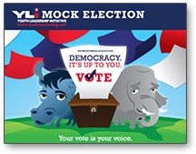
The Youth Leadership Initiative
Started in 1998
Over 70,000 Registered educators
Provides FREE civics resources for K-12 educators
Mock Election
E-Congress
Over 100 Lesson Plans
Interactive Games

Slide 10
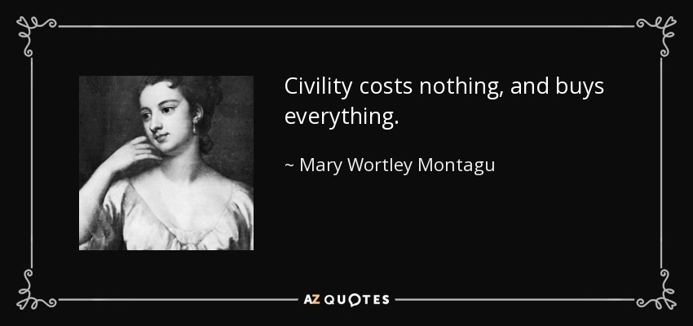
Talking Turkey…..
Teaching Civil discourse…
Empowering citizens to talk about politics
Making people feel welcome
Providing resources for learning about political topics
Creating a safe space

Slide 11
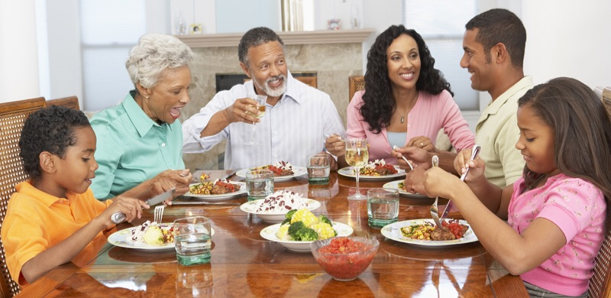
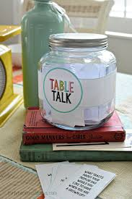
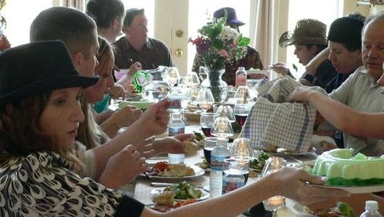
Materials:
Rules for Classroom Discussion/Social Contract
Resources for finding credible information on relevant topics:
Immigration
The Economy
Health Care
Civil Liberties/Terrorism
… More to come!!!!!

