Slide 1
Rebuilding Democracy
What citizens can do! Civic Engagement in action
Youth Leadership Initiative

Slide 2
How Much Danger is democracy in?
https://www.fivethirtyeight.com/features/how-much-danger-is-american-democracy-in/

Slide 3
Nativism
Nativism is the political policy of promoting the interests of native inhabitants against those of immigrants, including the support of immigration-restriction measures. In scholarly studies, nativism is a standard technical term, although those who hold this political view do not typically accept the label. Wikipedia

Slide 4
Illiberal Democracy
An illiberal democracy is a governing system in which, although elections take place, citizens are cut off from knowledge about the activities of those who exercise real power because of the lack of civil liberties; thus it is not an open society. Wikipedia

Slide 5
How do we measure democracy?
Conceptualizing and Measuring Democracy:
Tools

Slide 6
Public opinion
Why might some Americans be less optimistic about democracy?

Slide 7
Authoritarianism
Authoritarianism
Form of government
Authoritarianism is a form of government characterized by the rejection of political plurality, the use of a strong central power to preserve the political status quo, and reductions in the rule of law, separation of powers, and democratic voting. Wikipedia

Slide 8
Rules of civil discourse

Slide 9
Rule of Law
FLOURISHING ECONOMY
FREE AND FAIR ELECTIONS
FREE SPEECH
Equality
Quality Civic Education
Characteristics of a HEALTHY DEMOCRACY
FREE PRESS
EDUCATION FOR ALL
Lack of Political Polarization
DIVERSITY OF OPINION
Toleration

Slide 10
Comparing: Europe v. usa
regions_europe.mp4 - Review Link - April 26, 2021 - Frame.io
Why has POPULISM become popular around the world?
What challenges is democracy facing in Europe?
Are these challenges similar to those found in the US?

Slide 11
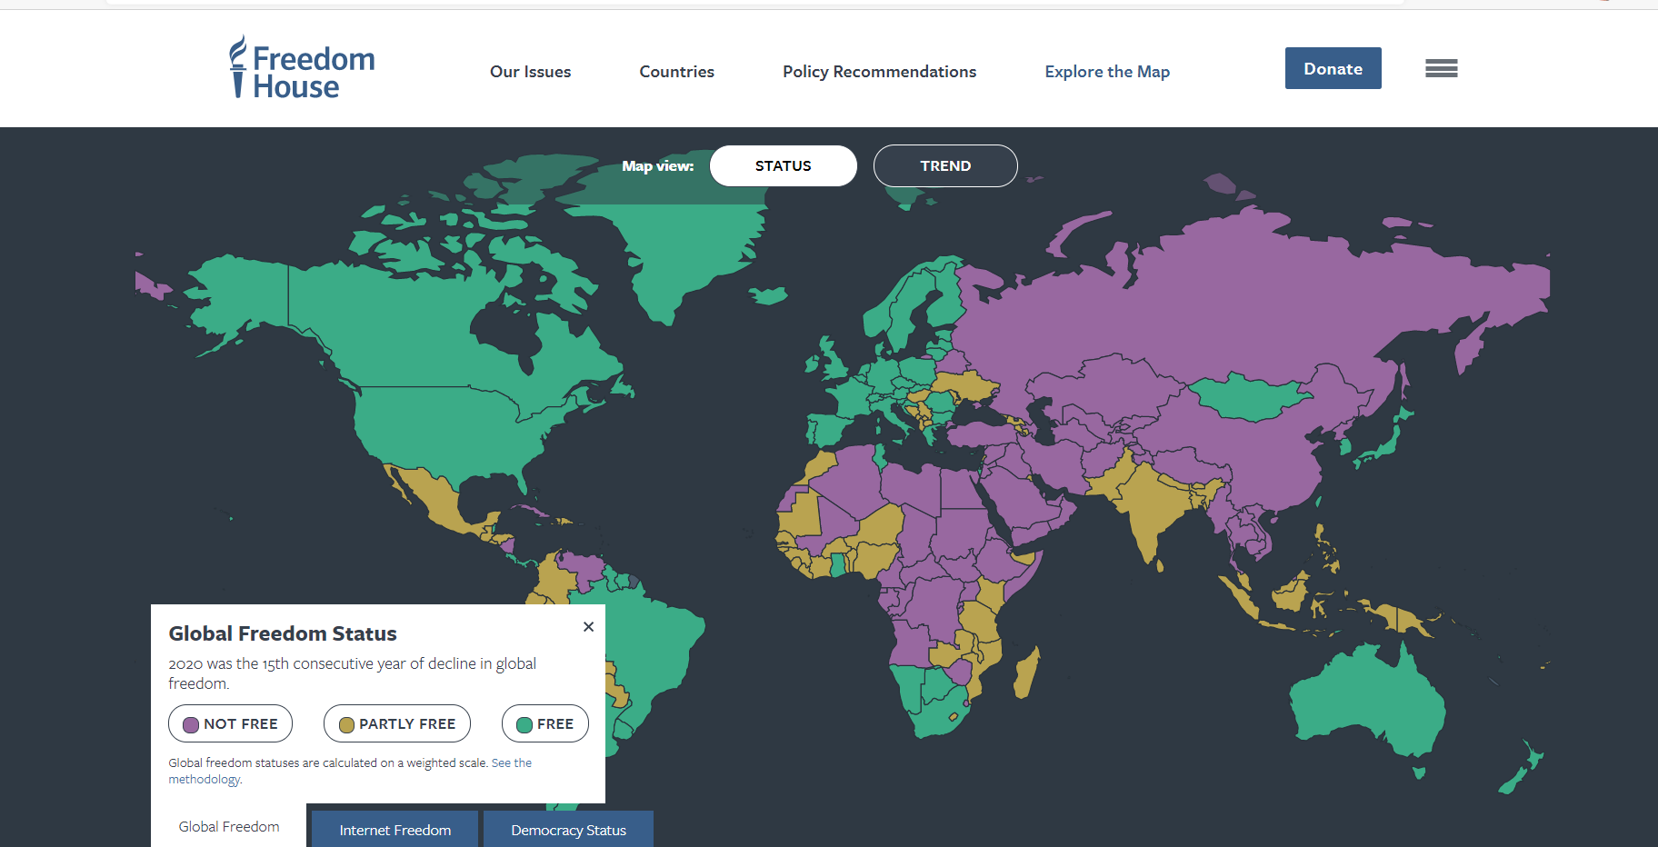
Explore the Map | Freedom House

Slide 12
Where do you rank your community?
What needs to change in YOUR community to bring democracy back to health?
What one action can you and your peers take to start that process?

Slide 13
Creating a Vision
Imagine what your community will look like when your action has been SUCCESSFULLY implemented.
Why does this image suggest a healthy democracy?

Slide 14
Think about
We have discussed many causes for the backslide of democracy in the recent past. What do you think is the most legitimate cause and what do you think will bring democracy back?
How important is citizen engagement to the health of a democratic republic?

