Slide 1
The Dreaded I-Word
Impeachment: The Indispensable Remedy?
What is it?
How does it work?
When should it be used?

Slide 2
Imagine that you have a job at the local convenience store. When you were hired you agreed to certain conditions that included arriving on time, dressing appropriately, completing certain tasks such as stocking deliveries, keeping the lavatories clean, and handling customers in a friendly manor. Most importantly you were being trusted to preserve the safety and security of the establishment. You agreed to those conditions.
On Friday, a friend asks you if you want to go to a concert. You want to go but you have to work until well after the concert begins. You decide to leave work early, lock up the store and go to the concert. The store owner stops by and sees that the store was closed before normal closing time.
What should the owner do?
Should you be fired? Why? Why not?
Should the customers have say in what happens to your employment? Why or why not?

Slide 3
What about Elected officials?
Can they be fired?
Who can make that decision?
Who will replace them if they are removed?
Does this take power away from the people?
Corrupt Legislation (1896) by Elihu Vedder. Library of Congress Thomas Jefferson Building, Washington, D.C.

Slide 4
THE U.S. Constitution Article II, Section 4
Article II, Section 4. Text of Article 2, Section 4: The President, Vice President and all civil Officers of the United States, shall be removed from Office on Impeachment for, and Conviction of, Treason, Bribery, or other high Crimes and Misdemeanors. ... A conviction in the Senate requires 2/3 of the vote.

Slide 5
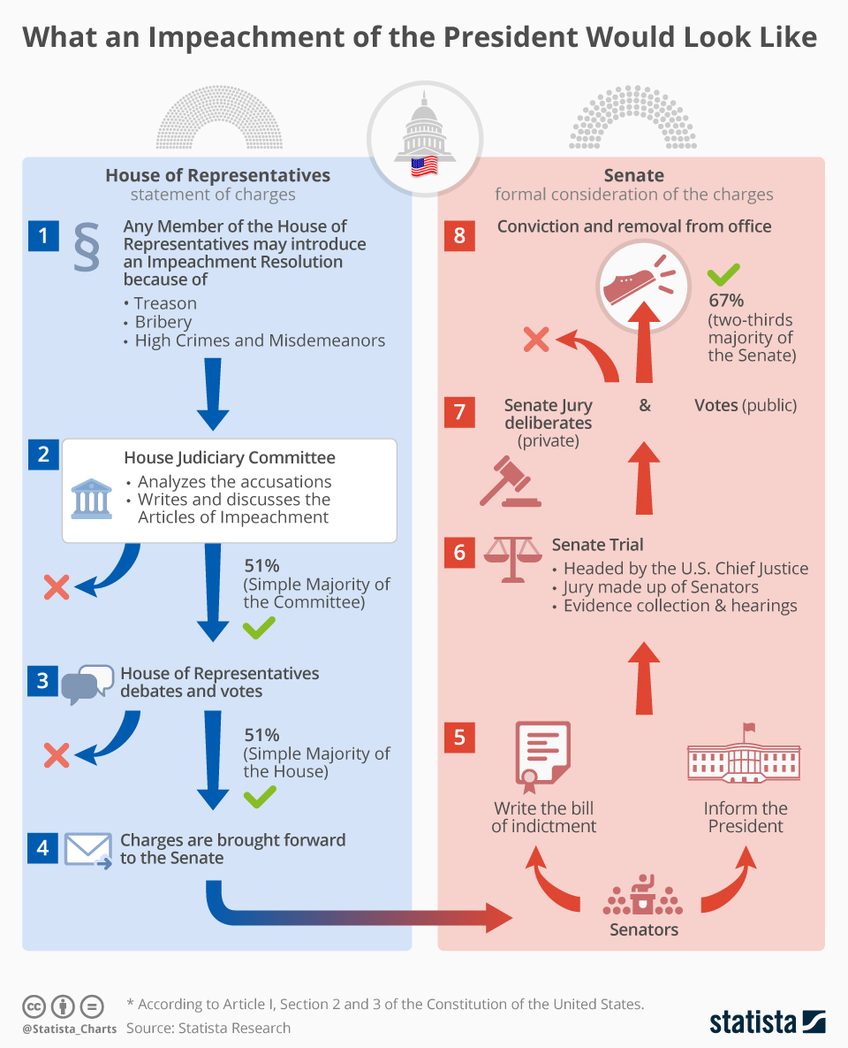
How does Impeachment work:
Is political not criminal
Congress cannot impose
criminal penalties
Treason as defined in the US Constitution, Article3, Section 3, Clause 1
Treason against the United States, shall consist only in levying War against them, or in adhering to their Enemies, giving them Aid and Comfort. No Person shall be convicted of Treason unless on the Testimony of two Witnesses to the same overt Act, or on Confession in open Court.

Slide 6
What the founders thought about removing elected officials…….
James Madison saw the Impeachment Clause as “indispensable . . . for defending the Community [against] the incapacity, negligence or perfidy of the chief Magistrate.”

Slide 7
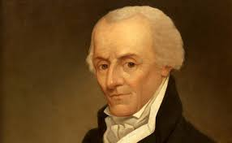
Elbridge Gerry stated that impeachment was needed as a check against presidential abuse of power. “A good magistrate will not fear [impeachments]. A bad one ought to be kept in fear of them,”

Slide 8
Governeur Morris feared that a President would feel beholden to the branch of government that could impeach him, leading the President to become “a tool of a faction.”

Slide 9
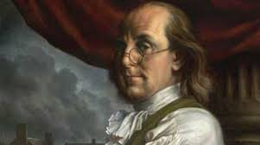
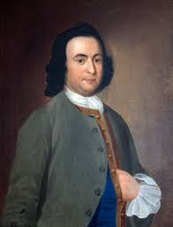
George Mason “No point is of more importance than that the right of impeachment should be continued. Shall any man be above Justice?”
Benjamin Franklin also said, in his unique way, the impeachment was preferable to the more traditional way of removing a monarch in Europe – by death.

Slide 10
Differences in the Constitutional Convention
https://constitutioncenter.org/blog/what-the-founders-thought-about-impeachment-and-the-president
Virginia Plan
New Jersey Plan
The Virginia Plan provided for removal of officers upon impeachment and conviction by the federal judiciary
New Jersey Plan neglected to include impeachment by the lower house and provided for removal only through application of a majority of the state governors.
The Compromise:
Alexander Hamilton then introduced his own plan based on the British legal system, where governors, Senators and other officials could be removed for “mal- and corrupt conduct” after being charged by the lower house and tried by the upper house.

Slide 11
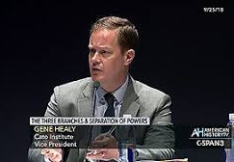
Things to Ponder:
Is Impeachment a political or legal proceeding?
Does an elected official have to commit a crime to be impeached?
Who decides the definition of “high crimes and treason?”
Why do you think the Founders did not give the impeachment power to the Judicial Branch?
Healy, Gene. A Constitutional Safety Valve. Cato Unbound, March 6, 2019

Slide 12
Impeachment Anxiety Syndrome (IAS)
Impeachment is a constitutional safety valve, not to be triggered lightly, but available for public protection when needed. Yet judging how they talk about it, many of America’s political and intellectual leaders have come to view the remedy itself as a menace to ordered liberty- a sort of doomsday device that the framers, in their perversity, wired into our Constitution.
Sometimes referred to as the Constitutional Nuclear Weapon
Bob Bauer of NYU law terms this belief “Impeachment Anxiety Syndrome” that understates its intensity
Healy, 2019

Slide 13
Impeachment in US History
Andrew Johnson
William Jefferson Clinton
February 24, 1868
Violation of the Tenure of Office Act
Senate Failed to convict
October 8, 1998
Lying under oath and obstruction of justice
Senate failed to convict
The impeachment and trial of Andrew Johnson had important political implications for the balance of federal legislative-executive power. It maintained the principle that Congress should not remove the President from office simply because its members disagreed with him over policy, style, and administration of office. It also resulted in diminished presidential influence on public policy and overall governing power, fostering a system of governance which Woodrow Wilson referred to in the 1870s as "Congressional Government.
The impeachment proceedings for Bill Clinton may have boosted his popularity, as many viewed the Republican impeachment attempts as politically motivated.

Slide 14
Talking turkey: To Impeach? or not to impeach? that is the question.
Review your talking turkey rules for civil discourse resource
Recommit yourself to listening, finding areas of compromise, and asking good questions
Research your side of the discussion and come prepared not to ‘win’ but to inform and learn from others
The goal is to brainstorm how the impeachment process might be reformed
All ideas and opinions matter
Discourse, Debate and Compromise

